Slide 1



CENG408 2025-2026
02/06/2026
CHEST XPLAIN
Multi-Label Chest X-Ray Disease Classification and Explainability with Deep Learning
PRESENTED BY:
PRESENTED TO:
Yaren AKDOĞAN
Sezin KÖROĞLU
Cevdet Alp ÖZGÜN
İpek BAŞ
Salih Barkın AKKAYA
İbrahimTAŞPINAR
Cankaya University Computer Engineering Department

Slide 2

1 | Project Introduction &Problem Definition
2 | Motivation & Objectives
3 | Dataset and Preprocessing
4 | Deep Learning Architecture
5 | Explainable AI with Grad-CAM++
6 | Backend System Design
7 | Mobile Application Development
8 | TIGA Feedback & Project Impact
9 | Conclusion & Future Work
10 | References
OVERVIEW

Slide 3

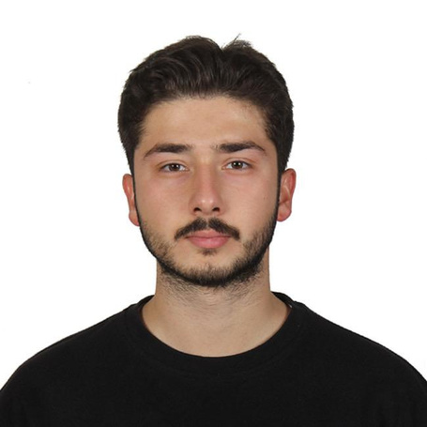

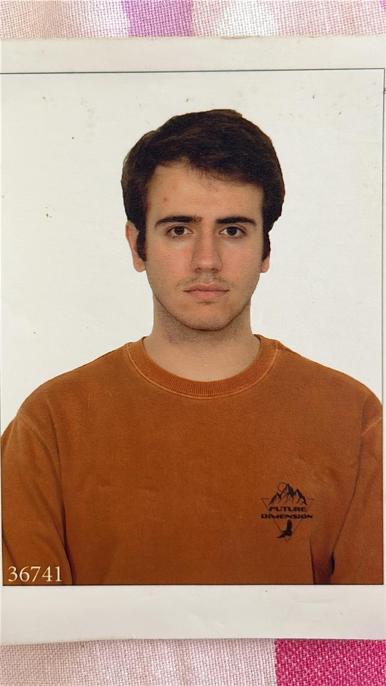
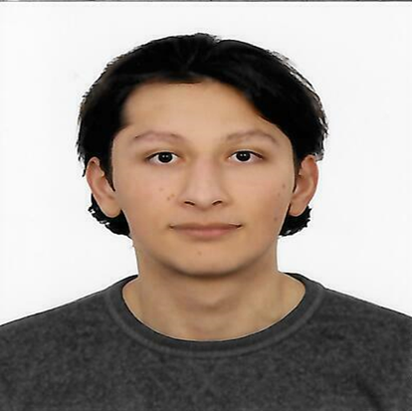
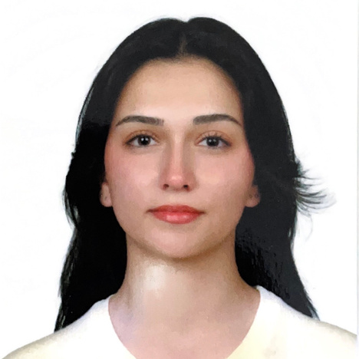
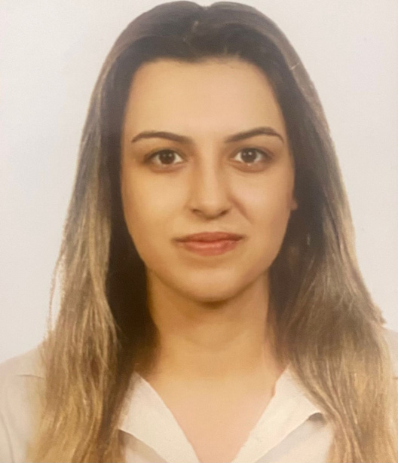
Our team
İPEK BAŞ
İBRAHİM TAŞPINAR
Mobile Application Developer
Mobile Application Developer
SALİH BARKIN AKKAYA
CEVDET ALP ÖZGÜN
Deep Learning & Model Development Team
Deep Learning & Model Development Team
YAREN AKDOĞAN
SEZİN KÖROĞLU
App Backend Development & API Integration
App Backend Development & API Integration

Slide 4
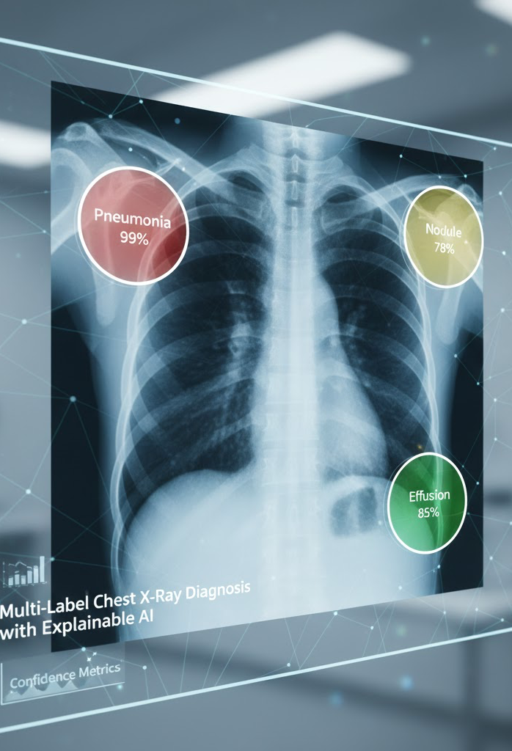
What does the system do?
It takes chest X-rays
It generates probability values for multiple diseases
It displays relevant regions as heat maps using Grad-CAM
It presents the results to the user on the Flutter interface
01
Solution approach:
NIH ChestX-ray14 dataset
CNN-based multi-label classification
Sigmoid output + BCE-based loss
Explainability with Grad-CAM++
Backend API + Flutter client integration
WHAT IS OUR PROJECT?
02
It is a deep learning-based classification and explainability system that simultaneously predicts multiple diseases from chest X-ray images. Model outputs are visualized using Grad-CAM to explain decision regions to the user, and results are presented via a mobile interface.
Project scope:
Model training and evaluation
Explainability visualizations
Simple and accessible user interface
Deployed mobile application via React Native (Expo)
03

Slide 5

Project Motivation & Purpose
This project aims to support the automated detection of multiple thoracic pathologies from chest X-ray images and to enhance the clinical reliability of deep learning–based systems by incorporating Grad-CAM–driven explainability into the decision process.
# 1
#2
# 3
It was developed to support early diagnosis and make the classification of chest X-ray / thoracic diseases more reliable.
It offers explainability based on Grad-CAM++ along with accuracy and user accessibility.
Supports clinical and academic use by providing explainable decision support and a user-friendly prototype.

Slide 6



System Architecture / General Workflow
Data set → Model → Backend → Flutter Application
Backend
Data set
Model deployment
Prediction + Grad-CAM++ generation
Result delivery via API
NIH ChestX-ray14
Preprocessing & data imbalance solutions
Model
React Native Interface
CNN-based multi-label classification
Evaluation using AUC / Precision / Recall / F1
Image upload
Disease probability values
Grad-CAM++ heatmap display

Slide 7
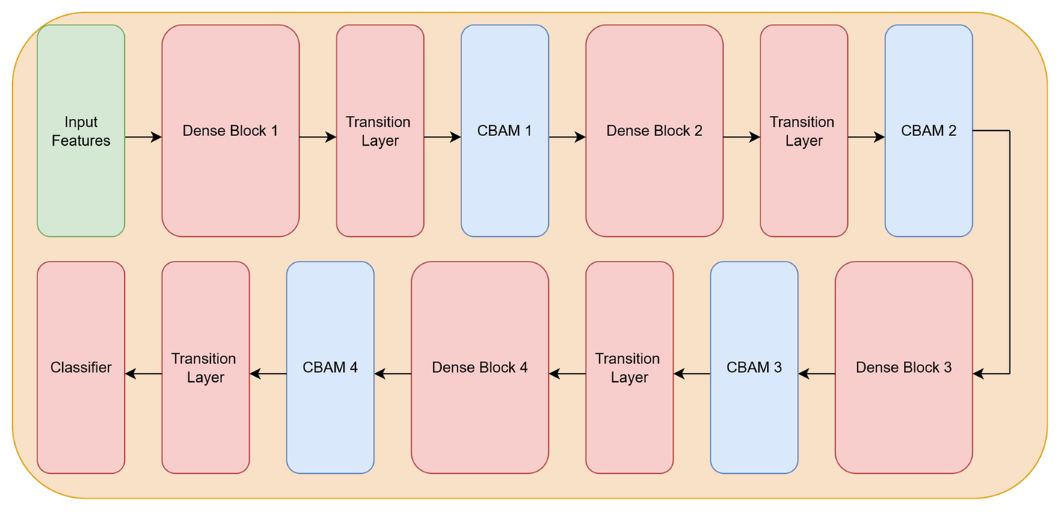
Model Architecture
•Backbone: DenseNet-121
•Frozen Layers: First Dense Blocks and Transition Layer
•Classifier: 14 class multi-label prediction output
•Feature Extraction: Four dense blocks with CBAM after each block
•Input Size: 512x512 grayscale

Slide 8
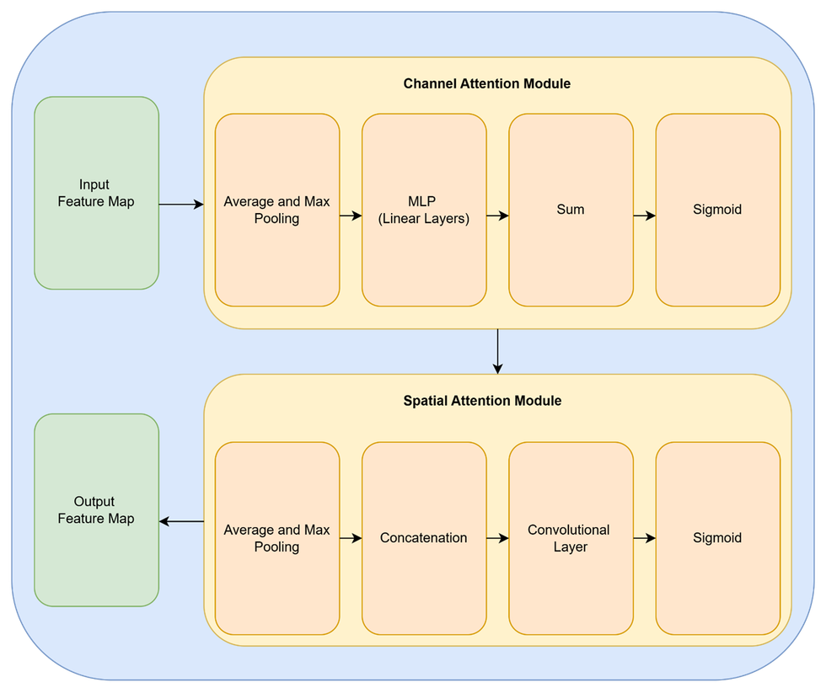
CBAM
(Convolution Block Attention Module)
Channel Attention
•Allows the model to distinguish which feature maps are important.
•Uses an MLP to update channel weights
Spatial Attention
•Allows the model to highlight specific areas on the feature map that are more relevant.
•Uses a convolutional layer to update individual values on the feature map.

Slide 9
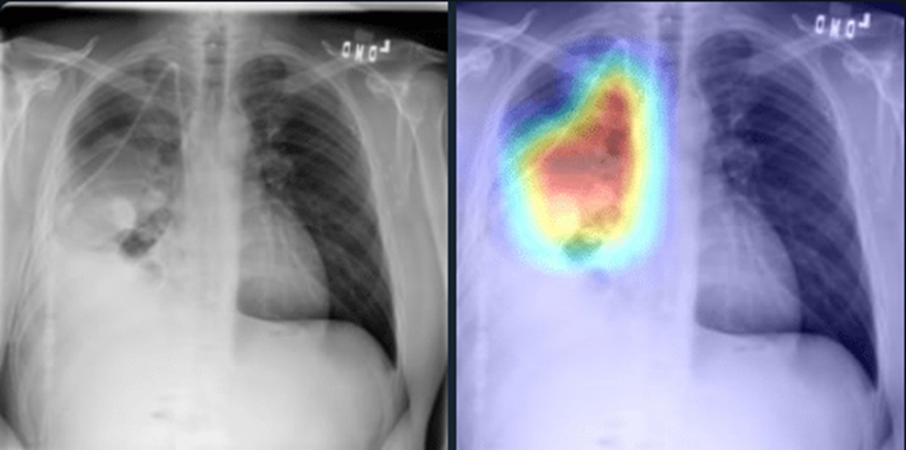
Standard GRAD-CAM++
(Gradient-weighted Class Activation Mapping)
• Uses gradients before the last convolutional layer (dense block) to generate heatmaps displaying areas that are relevant to the prediction.
• Generates separate heatmaps for each thoracic disease.
• Works well with CBAM.

Slide 10
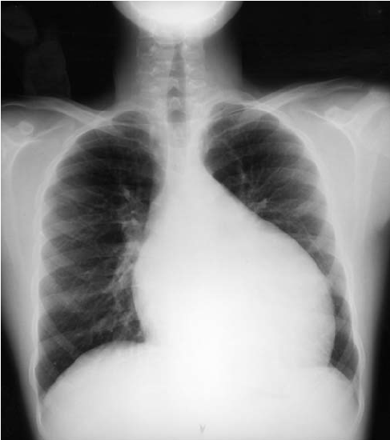
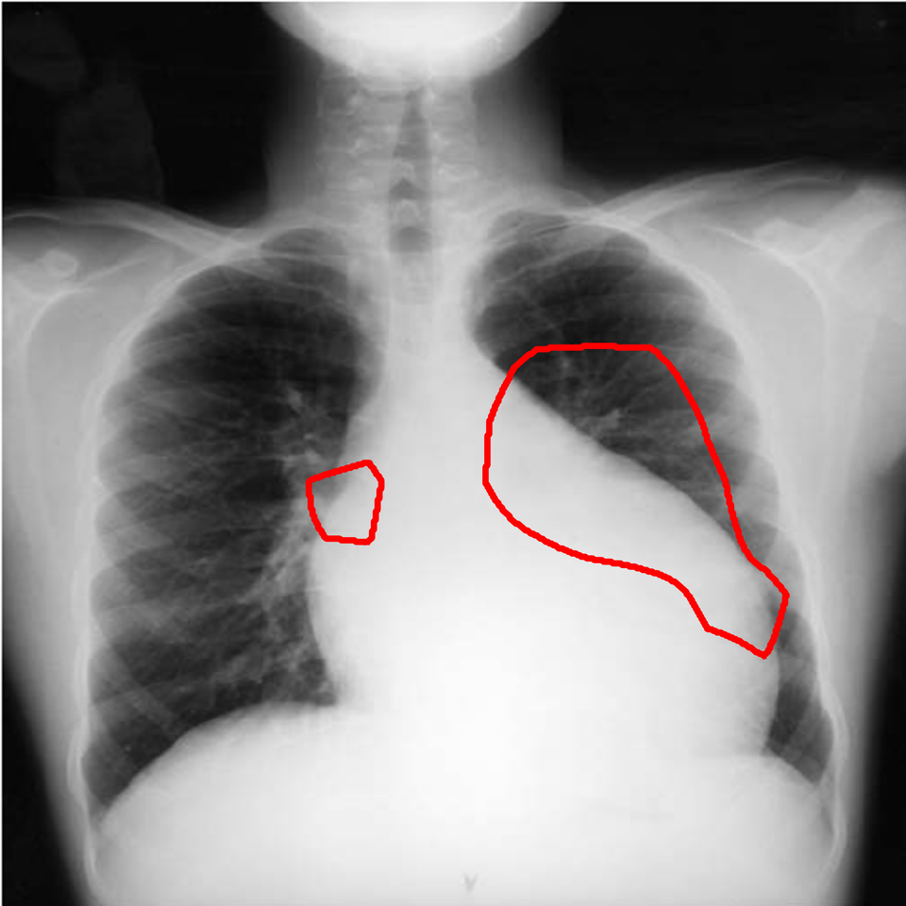
Contour Generation Using GRAD-CAM++
• Uses the heatmaps generated for image processing to generate hollow contours.
• Different illnesses can be visualized at the same time thanks to GRAD-CAM++.
• Utilizes the threshold values obtained during training.
• Allows for easier understandablitiy than standard GRAD-CAM++.

Slide 11
Trained Models: Model 1
Configuration:
Architecture: DenseNet-121.
Loss Function: Binary Cross-Entropy (BCE).
Dataset: Raw Images.
Thresholding: Static (0.50) for all classes.
Learning Rate / Epoch: 1e−4 / 15
Observation:
The model is biased toward the negative class, leading to high accuracy but poor sensitivity to diseases.
Low Macro F1 (0.27) confirms the model struggles to detect rare pathologies.
Rationale: This baseline highlights the limitations of standard BCE in handling class imbalance, justifying the move to advanced loss functions.

Slide 12
Trained Models: Model 2
Configuration:
Architecture: DenseNet-121.
Loss Function: Asymmetric Loss (ASL).
Dataset: Raw Images.
Thresholding: Static (0.50) for all classes.
Learning Rate / Epoch: 1e−4 / 15
Observation:
The model stops focusing only on Healthy cases and starts identifying disease markers.
Rare disease detection is improved, increasing Macro F1 to 0.34.
Rationale: Using ASL prevents the model from ignoring rare pathologies, solving the main issue of the baseline model.

Slide 13
Trained Models: Model 3
Configuration:
Architecture: DenseNet-121.
Loss Function: Asymmetric Loss (ASL).
Dataset: CLAHE + Gamma Corrected Images.
Thresholding: Static (0.50) for all classes.
Learning Rate / Epoch: 1e−4 / 15
Observation:
Image enhancement was used to make subtle features clearer for the model.
Macro F1 dropped to 0.32.
Rationale: Heavy enhancements introduced artifacts that distracted the model, proving that raw images provide more reliable features for this architecture.

Slide 14
Trained Models: Model 4 (Final Optimized Model)
Configuration:
Architecture: DenseNet-121.
Loss Function: Asymmetric Loss (ASL).
Dataset: Raw Images.
Thresholding: Dynamic Optimization (Class-Specific).
Learning Rate / Epoch: 5e−5 / 15
Observation:
Achieved the highest Macro F1 score (0.36), effectively bridging the gap between algorithmic output and clinical needs.
Replaced static 0.50 thresholding with class-specific cutoffs to maximize sensitivity for each pathology.
Result: This configuration is our final, most reliable solution for the diagnostic system.

Slide 15
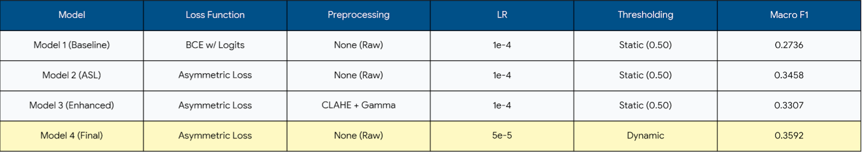
Comparison of Models

Slide 16
Backend Architecture & Core Services
Cloud-Based NoSQL Foundation: The system has transitioned to cloud-based MongoDB Atlas to leverage its flexible document-based structure and meet future scalability requirements.
Decoupled Architecture: For a clean separation of concerns, the data structure is split into independent collections for users, patients, hospitals, and analyses.
Development Framework: The FastAPI framework was selected due to its high performance, automatic API documentation, and seamless integration with Python-based AI/ML libraries.

Slide 17

Data Security & Patient Privacy
Cryptographic Password Hashing: User and doctor credentials are never stored in plain text and are securely hashed using the bcrypt algorithm during registration.
Protocol ID Separation (Anonymization): Sensitive personal data like National ID numbers are used only once to prevent duplicate records; all subsequent operations are anonymized via a unique Protocol ID.
Multi-Stage Admin Approval: To ensure medical data security, newly registered doctor accounts are created in a "pending" status and require explicit administrator approval before activation.
Network & Access Control: All data interactions are handled exclusively through structured REST API endpoints, with no direct database access exposed to the client.

Slide 18
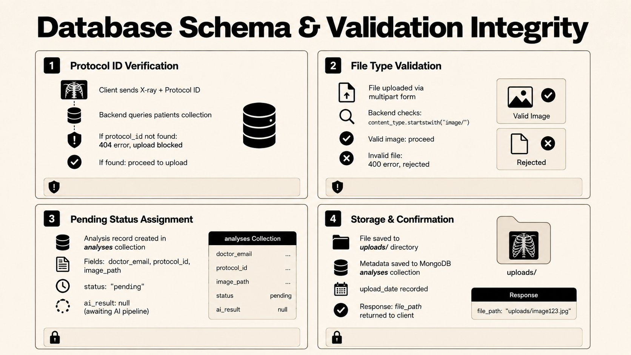

Slide 19
Frontend–Backend Integration & Workflow Actuation
Authentication
Image Upload & Pipeline Ignition
Doctor credentials entered via the React Native client are transmitted via a secure REST API, initiating a secure session only after bcrypt verification and admin approval (is_verified: true).
When an X-ray is selected, the file is posted alongside its Protocol ID, passing protocol verification and file type validation before being saved to a storage path with a 'pending' status.
Patient Management
AI Inference & Result Delivery
Upon creating a new patient, the backend optionally executes a National ID duplicate check and automatically returns a unique Protocol ID (e.g. P-102534) to the React Native client for all future operations.
After the X-ray is uploaded, the analysis record is saved to the analyses collection with a 'pending' status, ready to be processed by the AI pipeline.

Slide 20
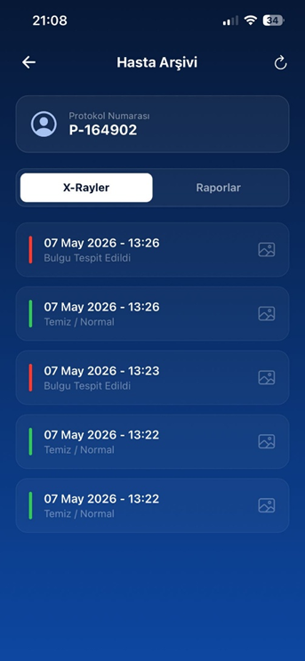
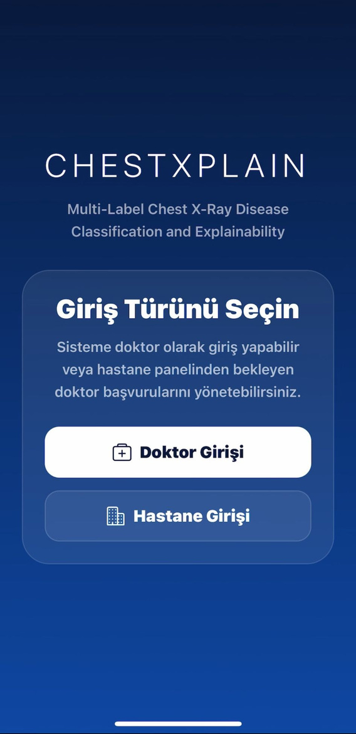
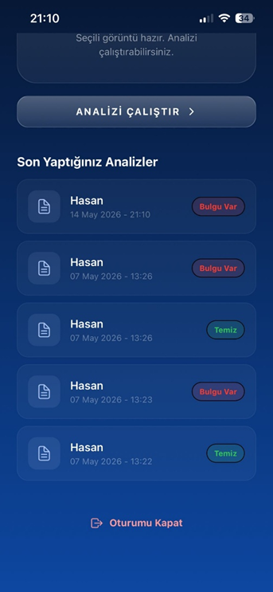
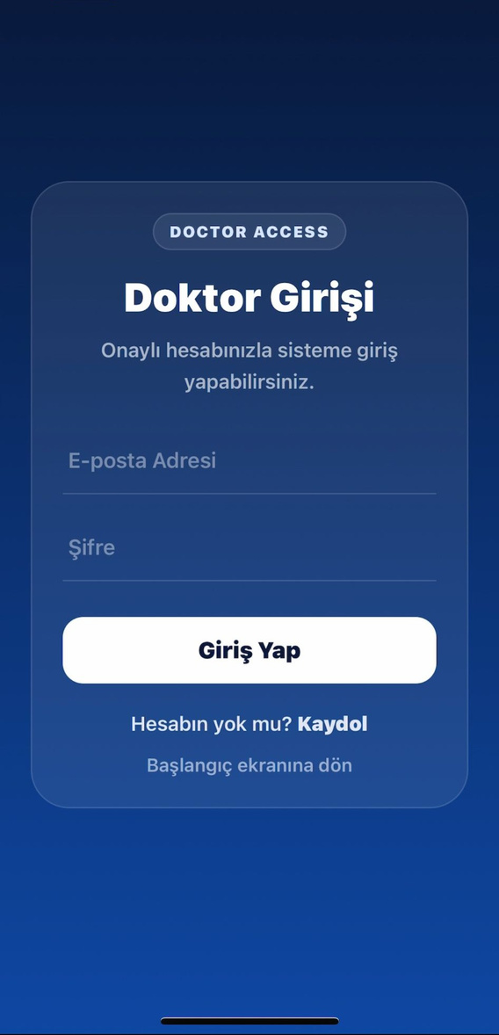
Secure User Access and Role-Based Authentication
Provides separate access paths for doctors and hospital administrators.
Guides users to the correct workflow through role-based navigation.
Ensures that only approved doctors can access clinical operations.

Slide 21
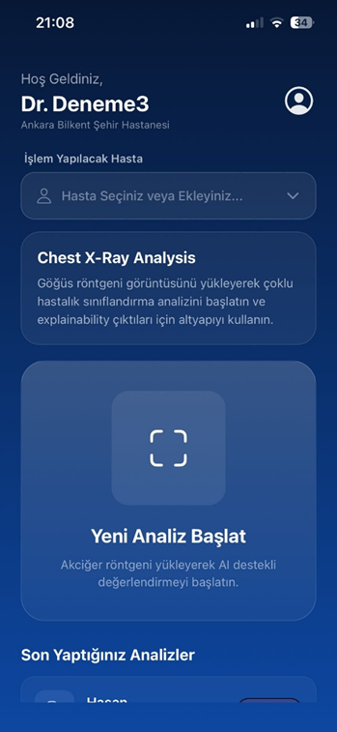
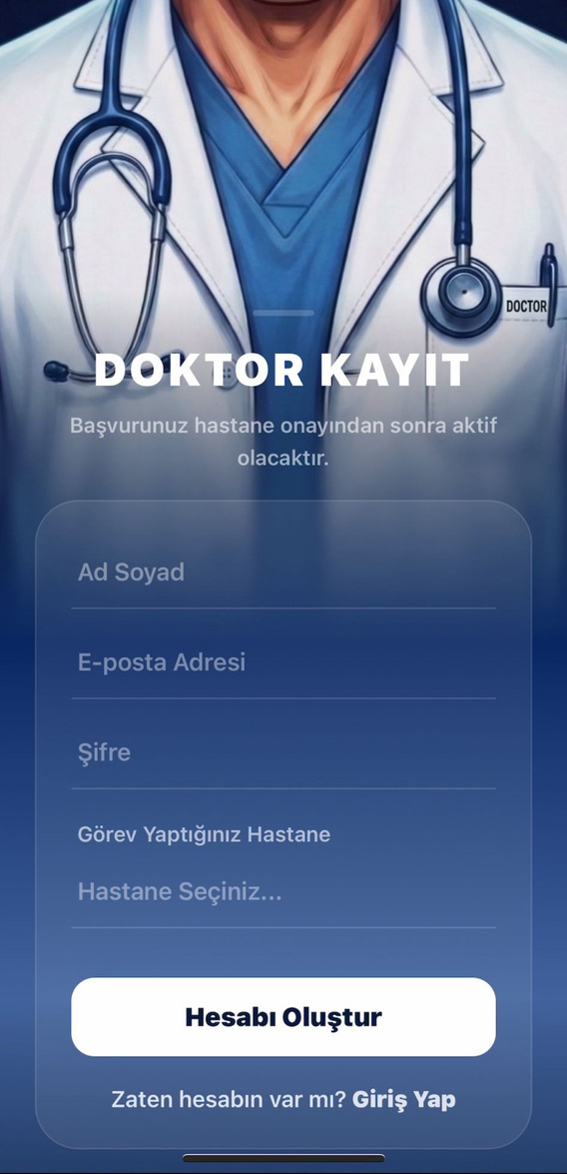
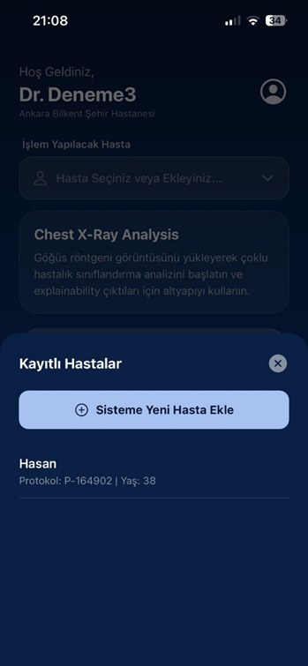
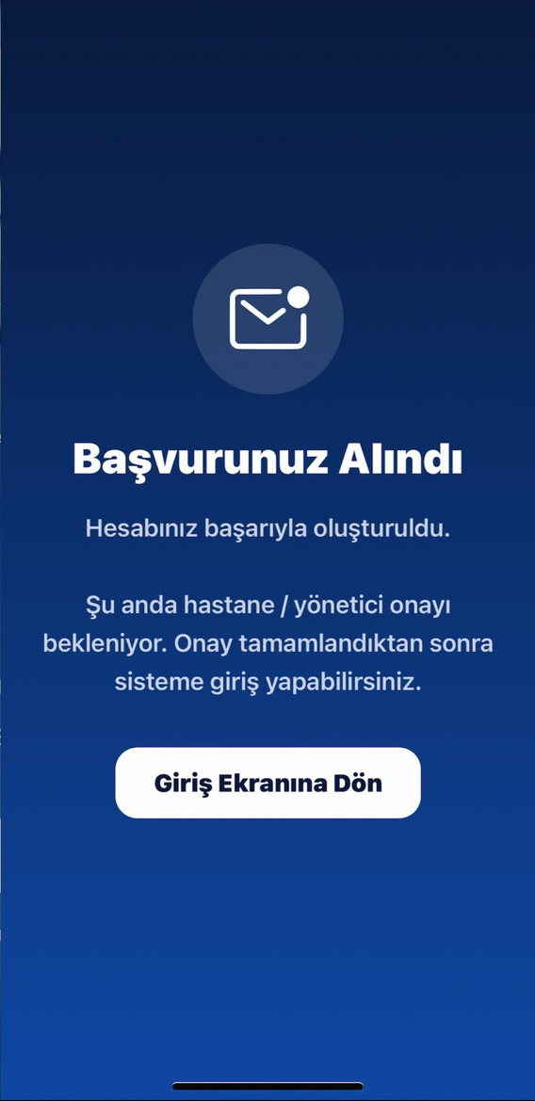
Doctor Registration and Pending Approval
Allows new doctors to register with personal credentials and hospital information.
Links each doctor account to a selected hospital before activation.
Keeps new accounts in pending status until hospital approval is completed.

Slide 22
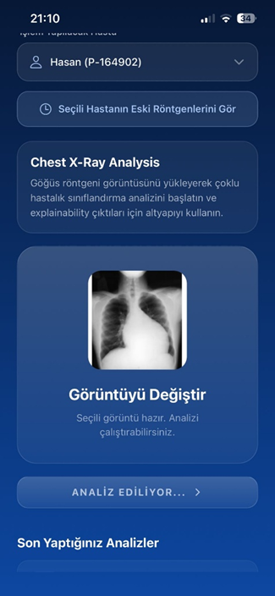
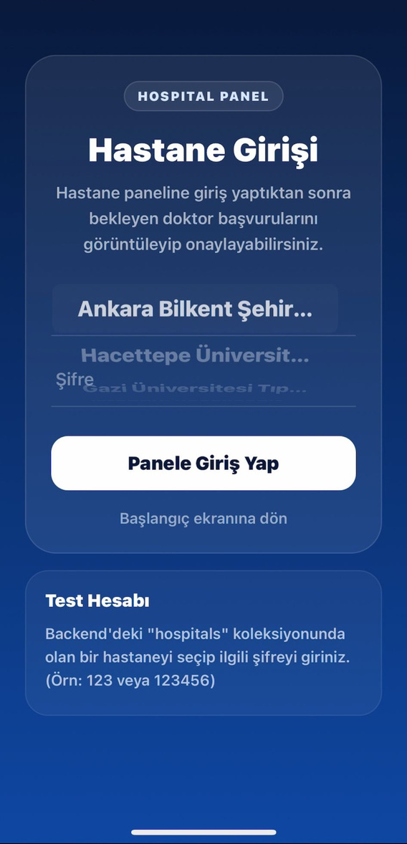
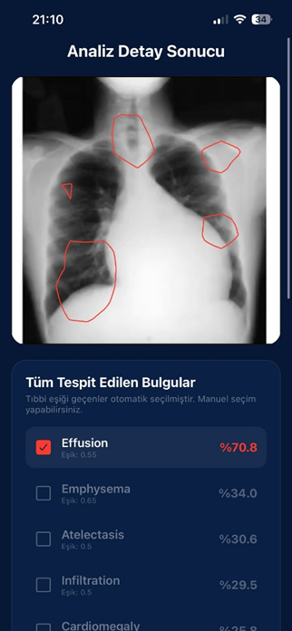
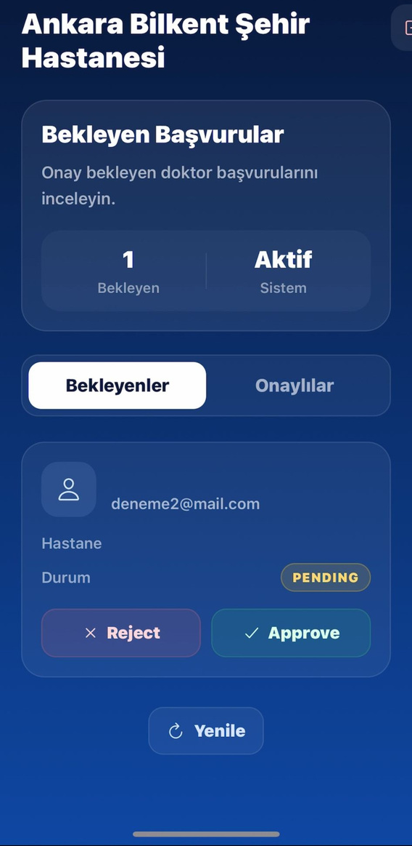
Hospital Authentication and Doctor Approval
Hospital administrators log in through a separate panel.
Pending doctor applications are listed according to the selected hospital.
Approved doctors become authorized users and can access the clinical dashboard.

Slide 23
Clinical Workflow and Patient Management
Structured mobile interface designed for real-world hospital environments.
Secure patient selection and registration module linked to unique Protocol IDs.
Provides a foundation for longitudinal medical tracking and data integrity.

Slide 24
Real-Time Processing and Explainable AI
The application executes an asynchronous request to the backend server where the deep learning architecture processes the X-ray.
The interface provides real-time status updates, such as the "Analyzing..." state, to mitigate user uncertainty during the high-computational phase.
Explainable AI (XAI) provides diagnostic visualization with disease contours.

Slide 25
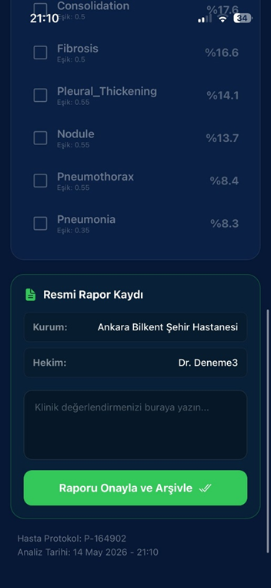
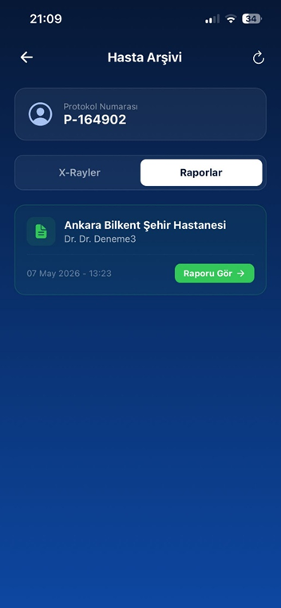
Seamless Diagnostic Reporting and Record Management
The interface transforms complex data into a streamlined reporting workflow, allowing the physician to finalize a diagnosis with minimal effort.
Doctors can easily review results, add clinical notes, and generate formalized reports directly within the application.
Reports are instantly synchronized with the patient's profile, facilitating quick access to historical diagnoses.

Slide 26
Integrated Digital Archiving and Diagnostic History
Centralizes all diagnostic activities for long-term patient management within a robust archiving system.
The "Patient Archive" allows physicians to toggle between raw X-ray results and finalized medical reports.
Dashboard featuring "Recent Analyses" provides high visual clarity with color-coded status indicators (Red for findings, Green for normal).

Slide 27
TİGA Feedback & Evaluation
During the TIGA evaluation process, valuable feedback was received regarding both the technical and usability aspects of the project.
Main recommendations included:
• Improving the explainability component to provide more intuitive visual outputs.
• Enhancing class imbalance handling for rare thoracic diseases.
• Strengthening the integration between the AI model and the mobile application.
• Expanding the security and patient management features of the backend system.
These recommendations guided the final development phase and contributed to the overall quality of the project.

Slide 28
Effects on the Project
The feedback obtained during the TIGA process directly influenced several improvements in the project.
Implemented improvements:
• Adoption of class-specific threshold optimization to improve diagnostic performance.
• Development of contour-based Grad-CAM++ visualizations for better interpretability.
• Enhancement of backend security through protocol-based anonymization and role-based access control.
• Refinement of the mobile user interface to support clinical workflows more effectively.
As a result, the project became more reliable, explainable, and suitable for real-world healthcare environments.

Slide 29
Conclusion & Contributions
A multi-label chest X-ray classification system was successfully developed using DenseNet-121 with CBAM attention modules, achieving a Macro F1 score of approximately 0.36, approaching human inter-radiologist agreement on the NIH ChestX-ray14 dataset.
GradCAM++ was implemented to provide spatial explainability, generating hollow vector contours that precisely localize detected pathologies on the X-ray without obstructing the underlying anatomy.
A secure, cloud-based backend was built on MongoDB Atlas with decoupled collections, bcrypt password hashing, protocol ID anonymization, and a multi-stage doctor approval mechanism to ensure data integrity and clinical security.
A fully functional React Native Interface was delivered, supporting role-based access, real-time analysis feedback, explainable AI visualization, physician reporting, and longitudinal patient archive management.

Slide 30
Future Work
The model will be extended to include AP (Anterior-Posterior) views alongside PA views to improve diagnostic reliability across different imaging positions.
Loss functions such as Focal Loss or Label Correlation Loss will be explored to better capture disease co-occurrence relationships and reduce false positives.
The GradCAM++ pipeline will be enhanced with adaptive contour extraction to maintain structural accuracy for diffuse pathologies such as Infiltration and Edema.
The database layer will be hardened by moving credentials to environment files, adding query indexes on frequently searched fields, and expanding the analyses collection to support doctor annotations and structured report generation.

Slide 31
THANK YOU FOR LISTENING
Q&A
CENG407

Slide 32

REFERANCES
Core Studies & Deep Learning
Wang et al., ChestX-ray8: Hospital-scale Chest X-ray Database and Benchmarks, CVPR 2017.
Huang et al., Densely Connected Convolutional Networks (DenseNet), CVPR 2017.
Rajpurkar et al., CheXNet: Radiologist-Level Pneumonia Detection on Chest X-Rays, 2017.
Irvin et al., CheXpert: A Large Chest Radiograph Dataset, AAAI 2019.
Attention & Explainability
Woo et al., CBAM: Convolutional Block Attention Module, ECCV 2018.
Selvaraju et al., Grad-CAM, ICCV 2017.
Chattopadhyay et al., Grad-CAM++, WACV 2018.
System Technologies
MongoDB Atlas Documentation.
FastAPI Documentation.
React Native Documentation.

